Slide 1

CREATIVE WAYS TO PRAY

Slide 2
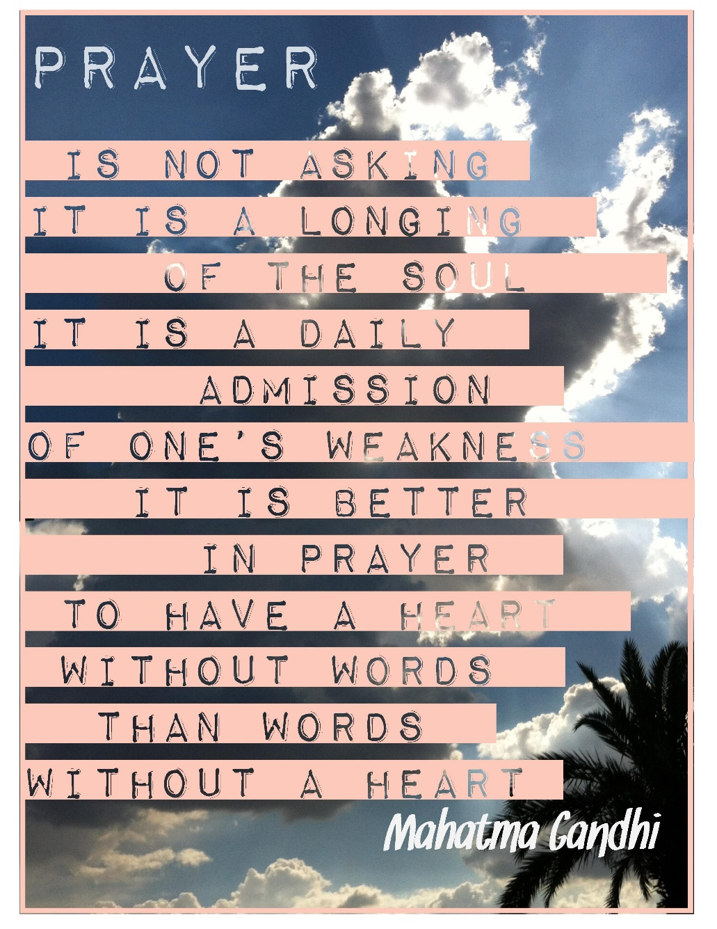

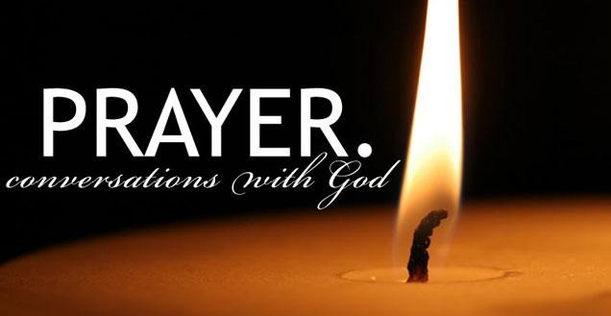

Slide 3
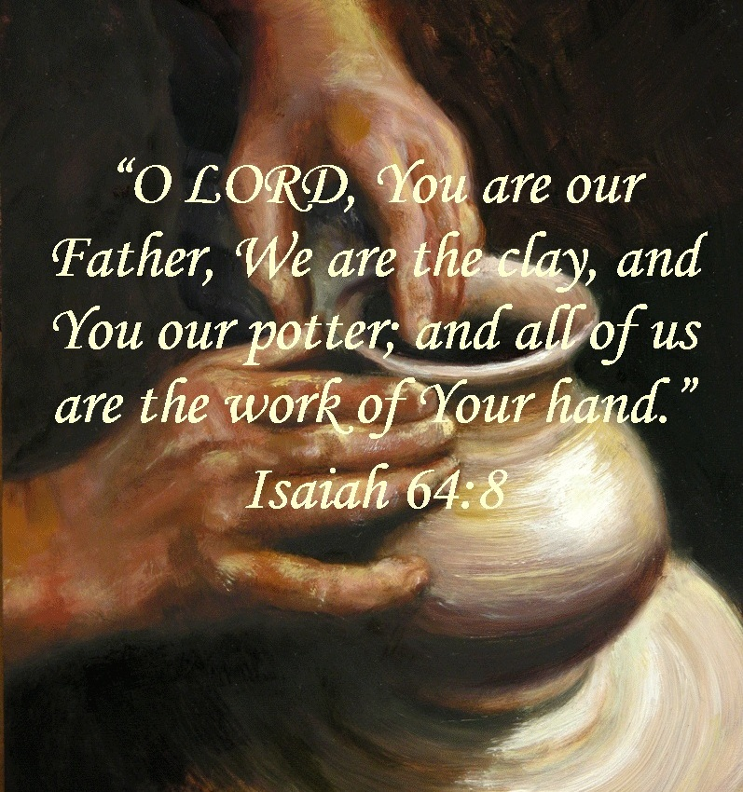
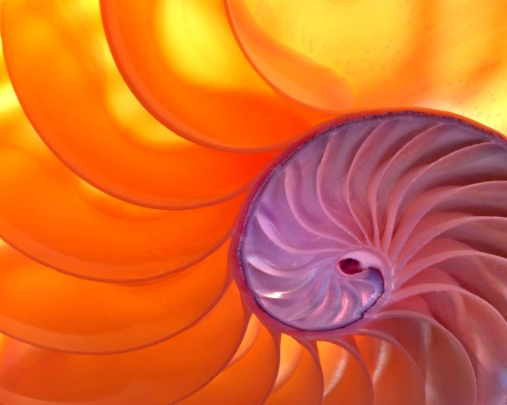
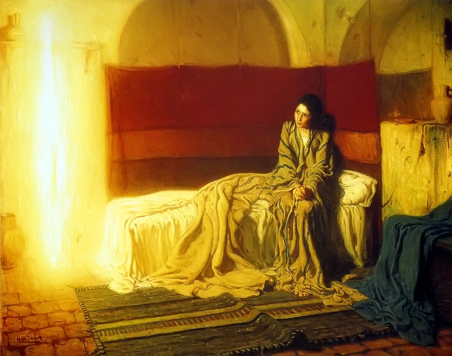
ART FOR REFLECTION

Slide 4

Appreciate my ability to breathe! Become aware of
the inhale / exhale rhythm.
Breathe in counting to four slowly: 1 – 2 – 3 – 4
Exhale: counting to four slowly: 1 – 2 – 3 – 4
Repeat three or four times allowing your breath to circulate within your body.
Imagine it travelling to the head, through the
heart, to the arms, to the feet.
Breath in God’s love, exhale any bitterness.
Breath in God’s calm, exhale any upset or anxiety.
Breath in God’s peace, exhale peace to the world
around you.
Etc. etc. etc.
Breath Prayer

Slide 5

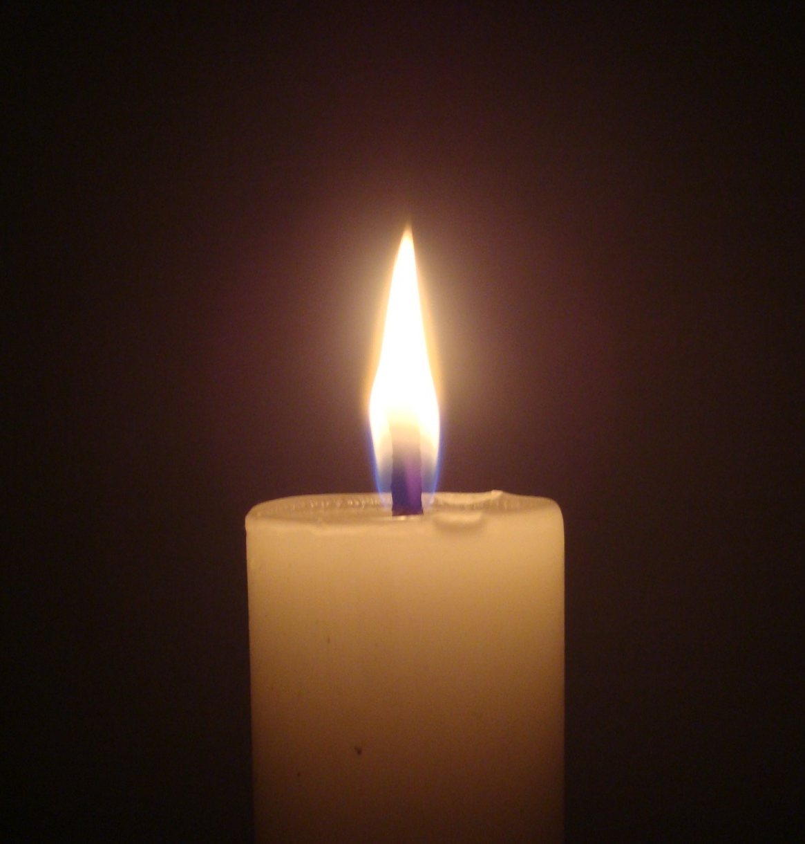
Centering Prayer
You may want to begin with the breath prayer.
Sit relaxed and gently close your eyes.
Be present in faith and love to God who dwells in
the center of your being.
Silently choose a word [mantra] and let it be
present to you. The word is simply a
means to turn my attention beyond myself and my
concerns.
Whenever I become aware of anything, I simply
return to God with the word that
I chose.
This is the whole prayer. We give ourselves
completely to God…just be in
God’s presence.

Slide 6
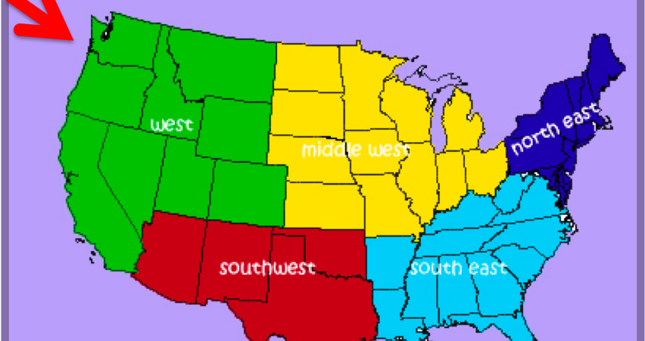

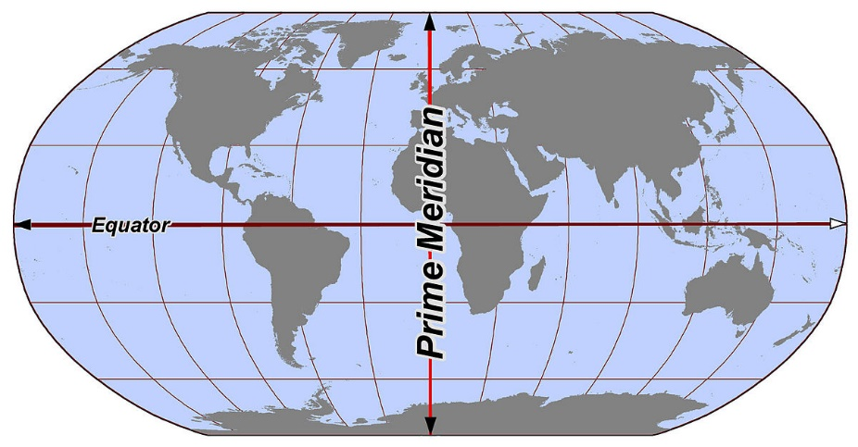

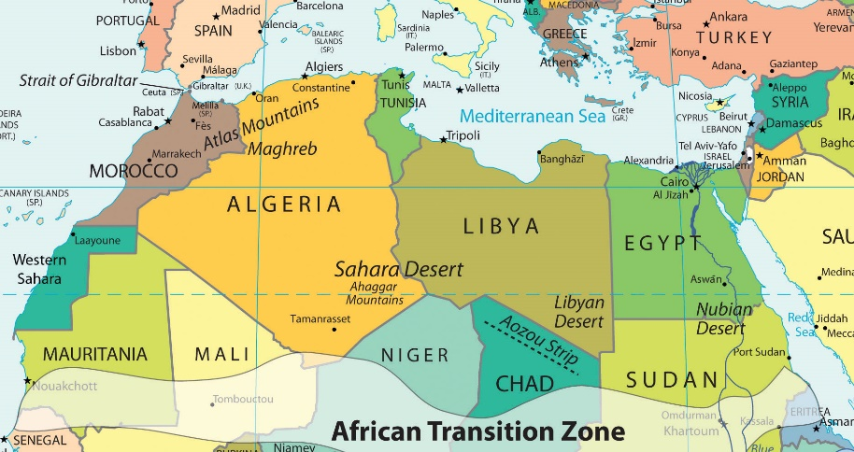
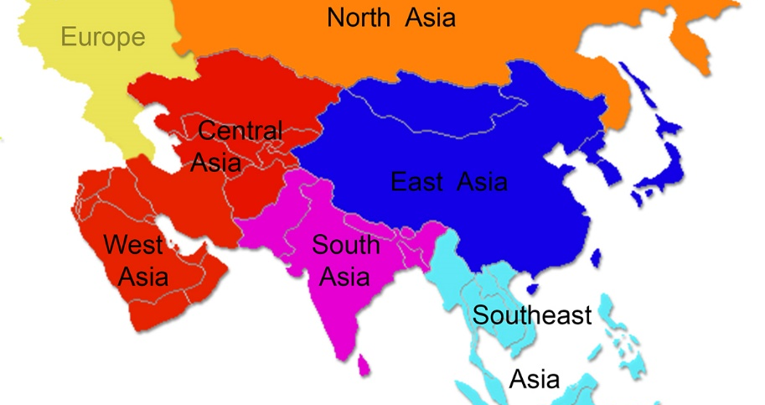
DIRECTION PRAYERS

Slide 7
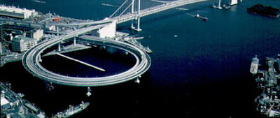
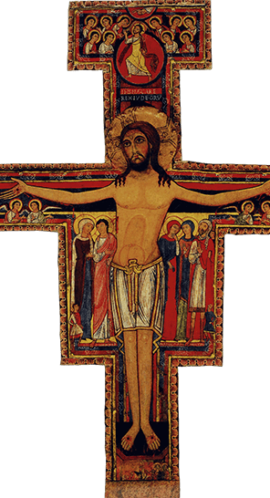
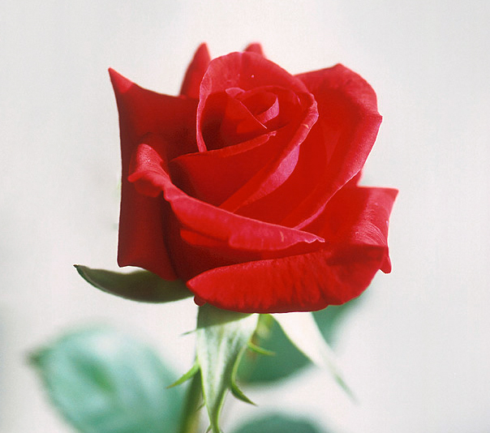
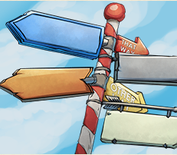


Images

Slide 8
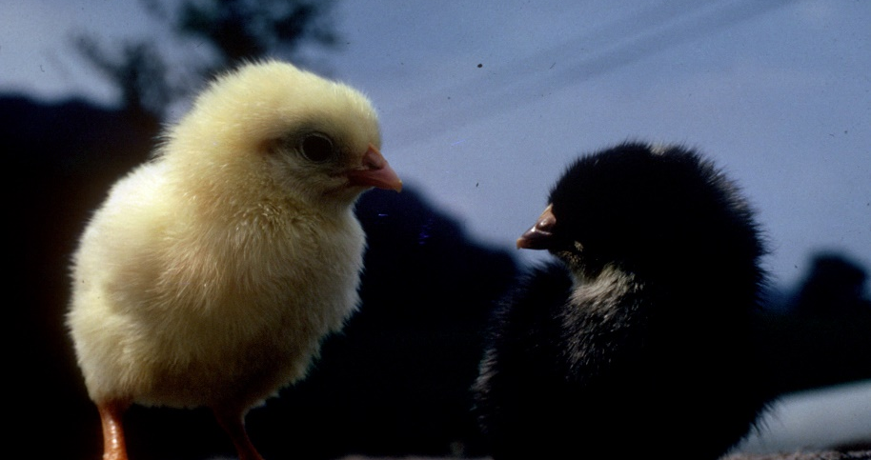
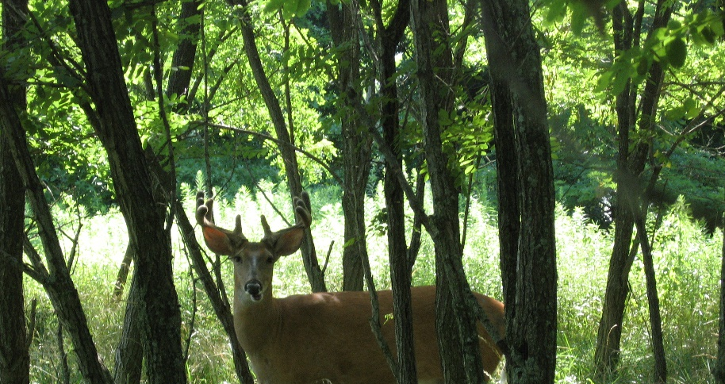
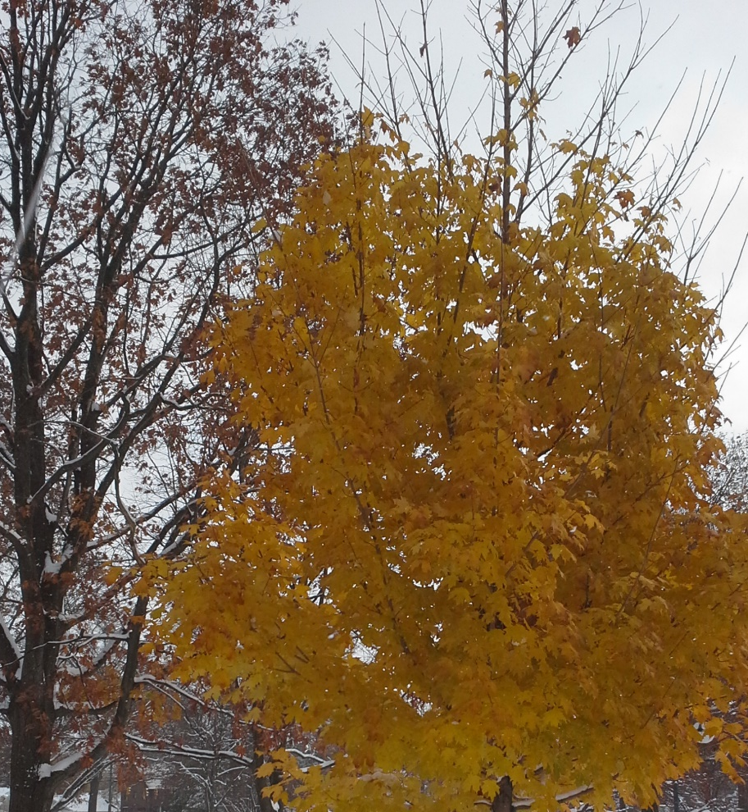
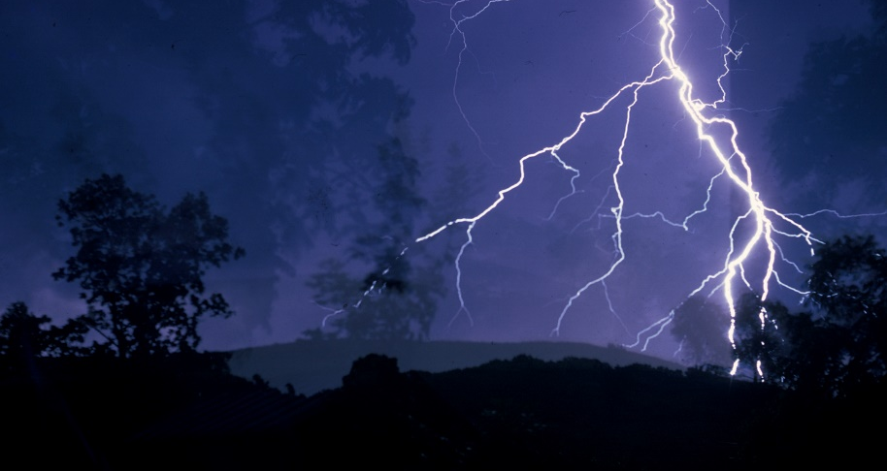
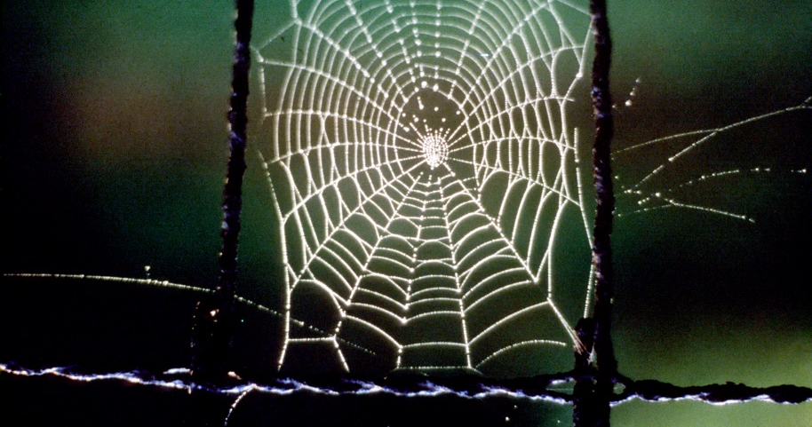

NATURE

Slide 9
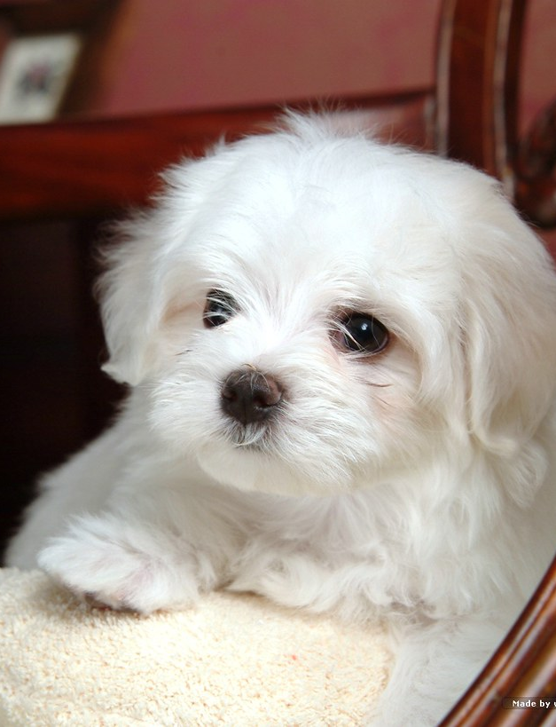
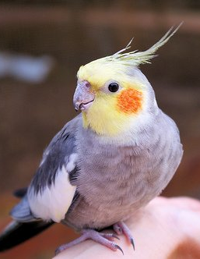
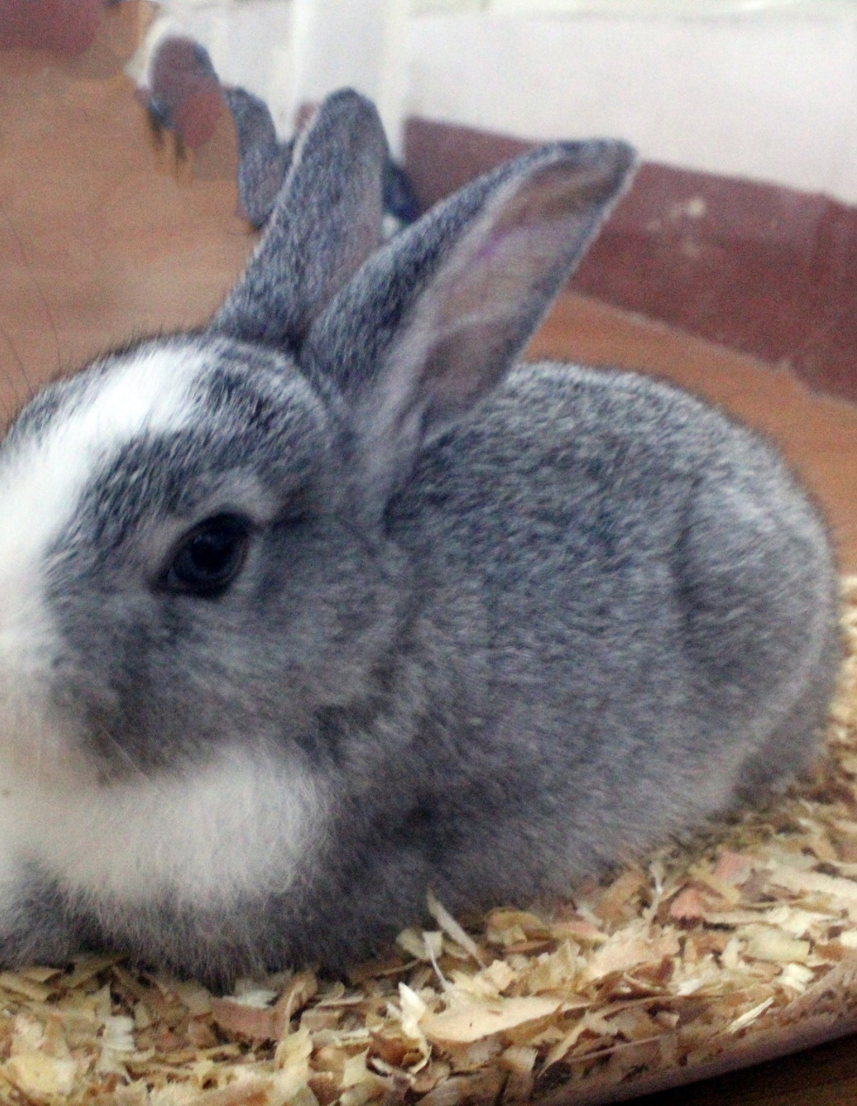
Pets…

Slide 10
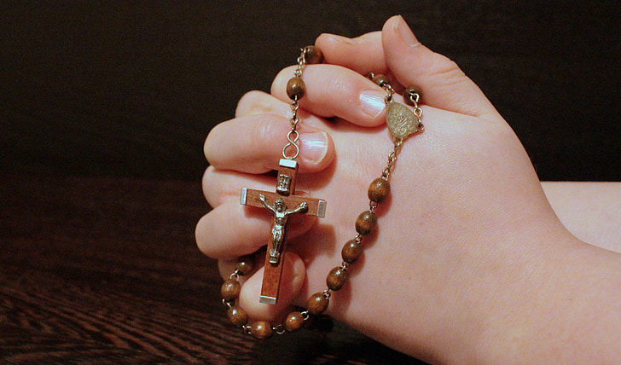

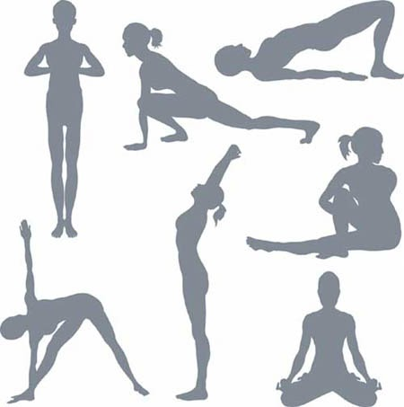
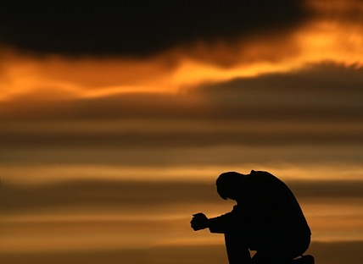
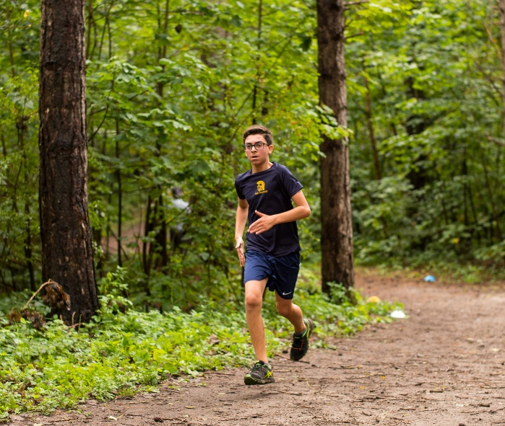
MOVEMENT

Slide 11
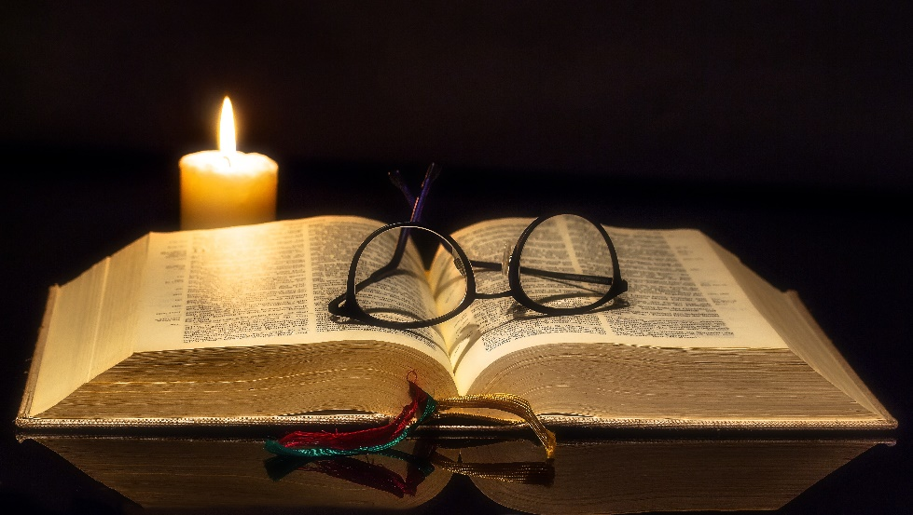
SCRIPTURE -- Just a few suggestions
Lectio Divina
Imaginative reflection
Using my senses to explore message
Dialog with persons in scene/ story
Applying message to myself, today’s world, etc
Re-write the story for today, for yourself
Just sit with it!

Slide 12
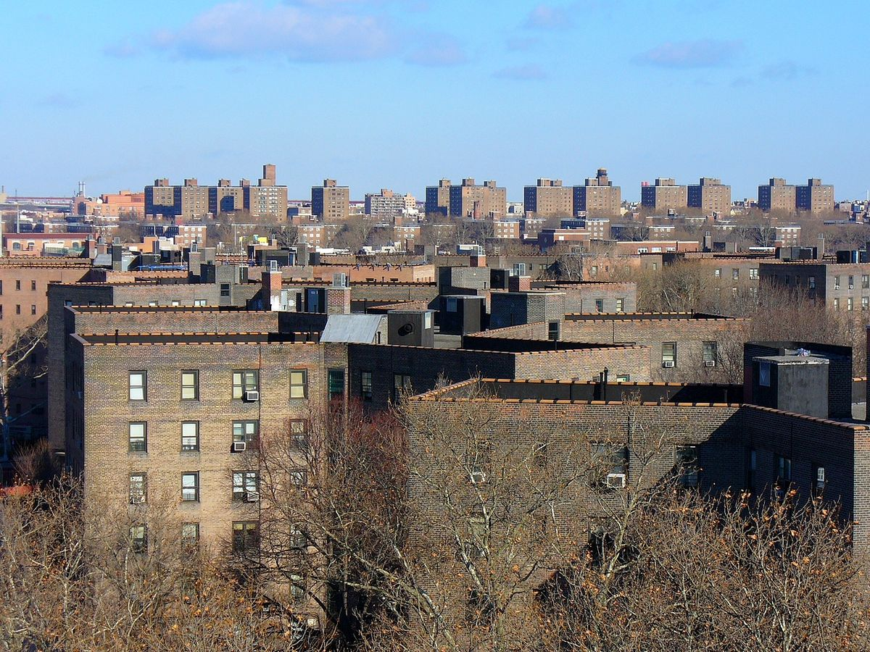



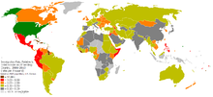
SOCIAL JUSTICE

Slide 13
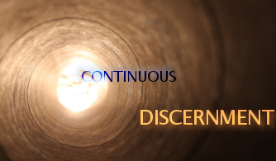





TRANSITIONS

